Slide 1




















A Mobile Application for Food Allergen Detection
Presentation by
Teng Wai Kie
20ACB04876

Slide 2



Content
Introduction
Literature Review
System Methodology
System Design
System Implementation
System Evaluation & Discussion
Conclusion

Slide 3









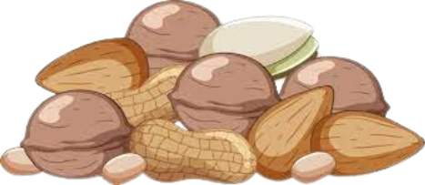
Background
Chapter 1 Introduction
Big-8 (Top Eight Allergens)
Milk
Egg
Fish
Shellfish
Tree nuts
Peanuts
Wheat
Soybean
What is Allergy ?
overreaction of the immune system to a substance that is typically harmless to most people.
Who will Allergy ?
Anyone, or a family history of allergies are at a higher risk

Slide 4
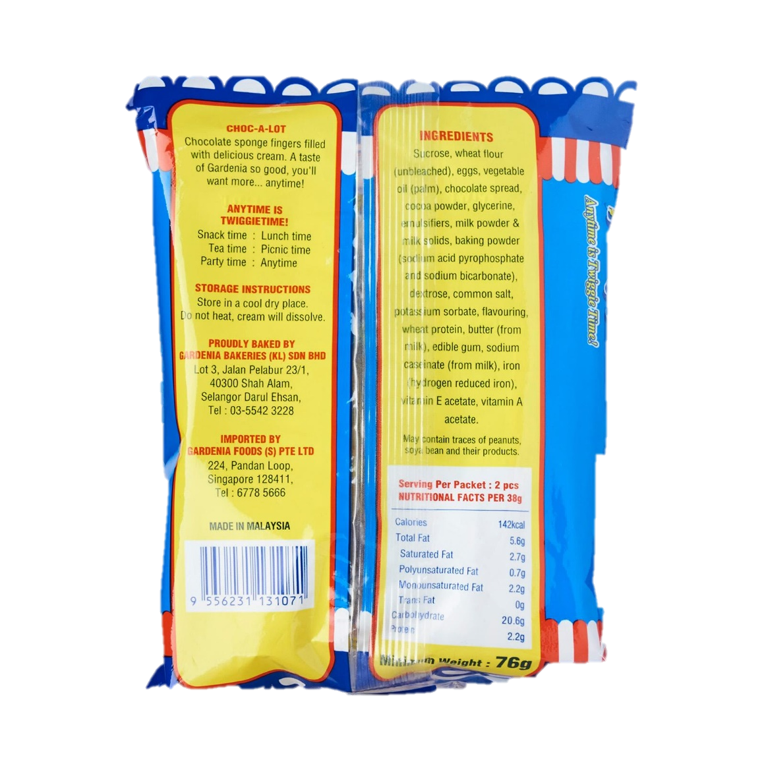



Problem Statement and Motivation
Chapter 1 Introduction
Project aims to analyze food ingredient lists in real-world images to assist people with specific allergens.
Goal is to develop a mobile app that detects and alerts users about allergens in food labels.

Slide 5

Problem Statement and Motivation
Chapter 1 Introduction
App aims to empower users to make informed dietary choices and enhance their quality of life.
App will be user-friendly, accurate, and fast, to cater to diverse food allergies.

Slide 6

Project Scope and Objective
Chapter 1 Introduction
To identify allergens, present in food ingredients simply by photographing the food's ingredient list.
To achieve a minimum image recognition accuracy of 90%, ensuring user safety and fostering trust.
Database Objective Adjusted:
- Original goal of maintaining a database for 1,000 food types was not achieved.
- Shifted focus to enable simultaneous detection of multiple allergens in a single food ingredient list.

Slide 7


Contribution
Chapter 1 Introduction
Identifying allergens in meals using food ingredient label photos.
App provides rapid feedback for allergy risk assessment before food consumption or purchase.
Allows users to upload or edit food-related information.
Aims to enhance quality of life for consumers with food allergies by enabling safer and more enjoyable food experiences.

Slide 8



Literature Review (Application)
Chapter 2 Literature Review
Article Title | Objective | Techniques Used | Application
Android Application for Food Allergy Detection using Machine Learning Technique | Predict food composition using machine learning. | - Long Short-Term Memory (LSTM) Networks: Predict food allergies in early life. - Convolutional Neural Networks (CNNs): Identify food items in images. - Image Processing: Obtain ingredients through image processing. - Threshold Segmentation Technology: Detect foreign bodies in food. | - Provides personalized allergy warnings based on food composition.

Slide 9
Literature Review (Application)
Chapter 2 Literature Review
Article Title | Objective | Techniques Used | Application
Food Image Recognition and Food Safety Detection Method Based on Deep Learning | Enhance food recognition accuracy. | - Tiny-YOLO and Twin Network: Two-stage learning mode (YOLO-SIMM) with versions YOLO-SiamV1 and YOLO-SiamV2. - Deep Learning: Used for food image recognition. - Foreign Body Detection: Separate foreign bodies from food using threshold segmentation. | - Improves food safety by identifying allergens and foreign bodies.

Slide 10
Literature Review (Application)
Chapter 2 Literature Review
Article Title | Objective | Techniques Used | Application
Mobile Phone Apps for Food Allergies or Intolerances in App Stores: Systematic Search and Quality Assessment Using the Mobile App Rating Scale (MARS) | Assess quality of food allergy/intolerance apps. | - Multidimensional Mobile App Rating Scale (MARS): Rates objective and subjective quality. - App Classification Categories: Descriptive aim, engagement, functionality, aesthetics, and information. - Output and Input Features Evaluation: Assess features related to food recognition and allergen information. | - Provides reliable and high-quality apps for managing food allergies/intolerances.

Slide 11
Literature Review (Image)
Chapter 2 Literature Review
Article Title | Objective | Techniques Used | Application
Text Detection and Recognition in Imagery: A Survey | Survey existing methods for text detection and recognition in images. | - Review of Various Techniques: Provides an overview of existing approaches, including traditional methods and deep learning-based techniques. - Categorization: Classifies methods into categories such as sliding window-based, connected component-based, and deep learning-based. - Challenges and Trends: Discusses challenges and emerging trends. | - Provides insights for researchers and practitioners in the field. - Helps identify gaps and areas for improvement.

Slide 12
Literature Review (Image)
Chapter 2 Literature Review
Article Title | Objective | Techniques Used | Application
OCR Accuracy Improvement on Document Images Through a Novel Pre-Processing Approach | Enhance OCR accuracy for document images. | - Novel Pre-Processing Approach: Introduces a new pre-processing method. - Image Enhancement Techniques: Likely includes noise reduction, contrast enhancement, and skew correction. - OCR Algorithms: Utilizes OCR algorithms for text extraction. | - Improves OCR accuracy for scanned documents. - Relevant for document digitization and archival systems.

Slide 13
Literature Review (Image)
Chapter 2 Literature Review
Article Title | Objective | Techniques Used | Application
WordFence: Text Detection in Natural Images with Border Awareness | Detect individual words in natural images. | - WordFence Concept: Proposes detecting border areas around words. - Pixelwise Weighted Softmax Loss Function: Introduced for training. - Superior Localization Recall: Achieves high recall on benchmark datasets. - End-to-End Word Recognition: Achieves state-of-the-art F-Score. | - Enhances word detection in scene images. - Valuable for scene understanding and object classification.

Slide 14
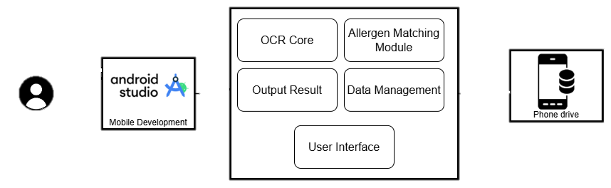

Chapter 3 System Methodology
System Architecture Diagram
Key Features
Notes:
Development Environment:
Android Studio:
Exclusively used for application development.
Provides tools for coding and integration of features.
Key Features and Modules:
OCR Detection:
Uses optical character recognition to extract text from photos (e.g., ingredient lists).
Converts visual data into text format for analysis.
Allergen Matching Module:
Compares extracted text with user-provided allergens.
Identifies potential allergenic components.
Data Management Module:
Stores user-provided allergen data securely.
Organizes and ensures easy access to the data when needed.
Output Result:
Processes and presents results to the user.
Clearly indicates if the food is safe or dangerous.
User Interface (UI):
Provides a visually appealing and intuitive platform.
Enables users to input allergen data and view results easily.
Testing Phase:
Smartphone Testing:
Conducted after development is complete.
Verifies application compatibility, performance, and user experience in real-world scenarios.
Ensures the application meets quality standards before release.

Slide 15




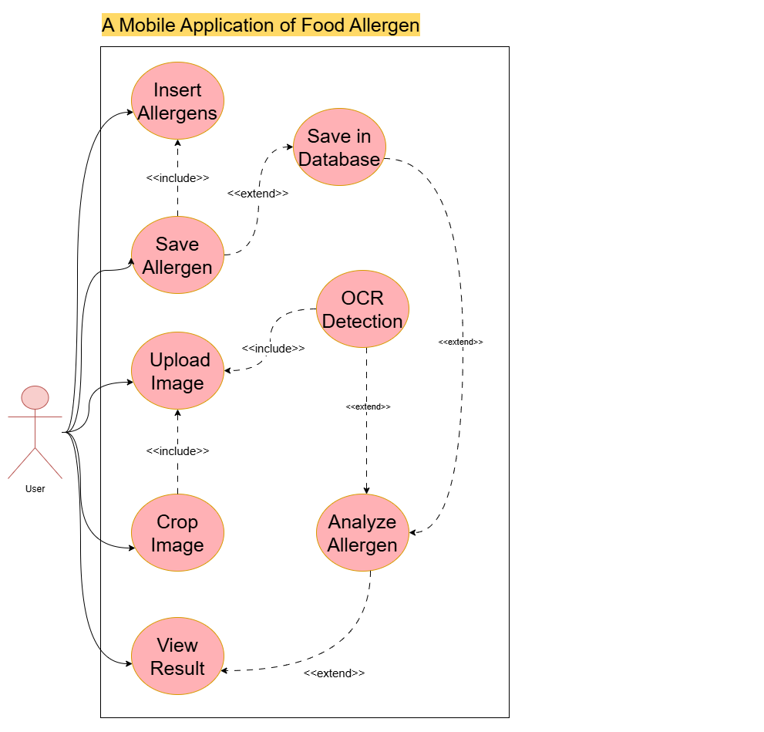


Use Case Diagram
Chapter 3 System Methodology

Slide 16
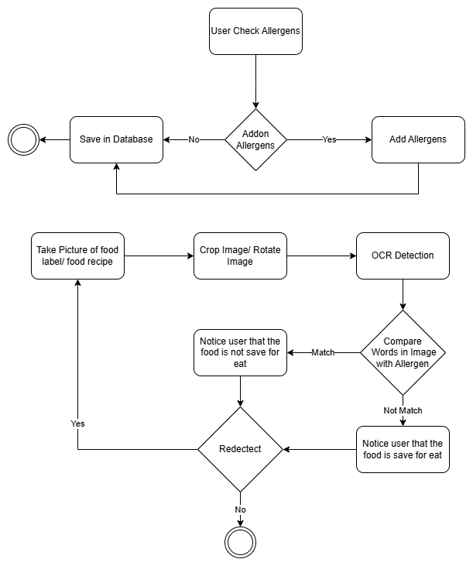
Chapter 3 System Methodology
System Architecture Diagram
User Save Allergens.
Notes:
Development Environment:
Android Studio:
Exclusively used for application development.
Provides tools for coding and integration of features.
Key Features and Modules:
OCR Detection:
Uses optical character recognition to extract text from photos (e.g., ingredient lists).
Converts visual data into text format for analysis.
Allergen Matching Module:
Compares extracted text with user-provided allergens.
Identifies potential allergenic components.
Data Management Module:
Stores user-provided allergen data securely.
Organizes and ensures easy access to the data when needed.
Output Result:
Processes and presents results to the user.
Clearly indicates if the food is safe or dangerous.
User Interface (UI):
Provides a visually appealing and intuitive platform.
Enables users to input allergen data and view results easily.
Testing Phase:
Smartphone Testing:
Conducted after development is complete.
Verifies application compatibility, performance, and user experience in real-world scenarios.
Ensures the application meets quality standards before release.

Slide 17
Chapter 3 System Methodology
System Architecture Diagram
User Detect Allergens.
Notes:
Development Environment:
Android Studio:
Exclusively used for application development.
Provides tools for coding and integration of features.
Key Features and Modules:
OCR Detection:
Uses optical character recognition to extract text from photos (e.g., ingredient lists).
Converts visual data into text format for analysis.
Allergen Matching Module:
Compares extracted text with user-provided allergens.
Identifies potential allergenic components.
Data Management Module:
Stores user-provided allergen data securely.
Organizes and ensures easy access to the data when needed.
Output Result:
Processes and presents results to the user.
Clearly indicates if the food is safe or dangerous.
User Interface (UI):
Provides a visually appealing and intuitive platform.
Enables users to input allergen data and view results easily.
Testing Phase:
Smartphone Testing:
Conducted after development is complete.
Verifies application compatibility, performance, and user experience in real-world scenarios.
Ensures the application meets quality standards before release.

Slide 18
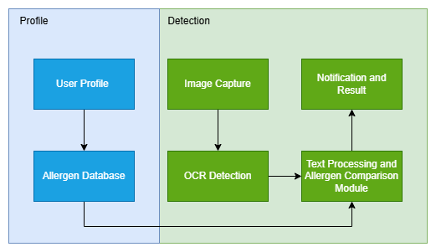

System Block Diagram
Chapter 4 System Design

Slide 19
System Block Diagram
Chapter 4 System Design
Allows the user to upload an image
Represents the personalized information
Displays the results
storage of allergens
Compares the processed text with the allergen database
processes that captured image

Slide 20
Tools
Chapter 5 System
Implementation
Hardware
Description | Specifications
Model | Asus TUF Gaming F15 FX506HC
Processor | 11th Gen Intel(R) Core (TM) i5-11400H @ 2.70GHz 2.69 GHz
Operating System | Windows 11
Graphic | NVIDIA® GeForce RTX™ 3050
Memory | 8GB DDR4-3200 SO-DIMM
Storage | 512GB PCIe® 3.0 NVMe™ M.2 SSD
Description | Specifications
Model | Oppo Reno8 T 5G
Processor | Snapdragon 695 5G (6 nm)
Operating System | Android 14, ColorOS 14
Graphic | NVIDIA® GeForce RTX™ 3050
Memory | 8GB RAM
Storage | 256GB
Specifications of laptop Specification of Smart Phone

Slide 21



Tools
Chapter 5 System
Implementation
Software
Android Studio
Fully utilized for coding
GitHub
utilized as the version control and backup platform
Photoshop
design

Slide 22
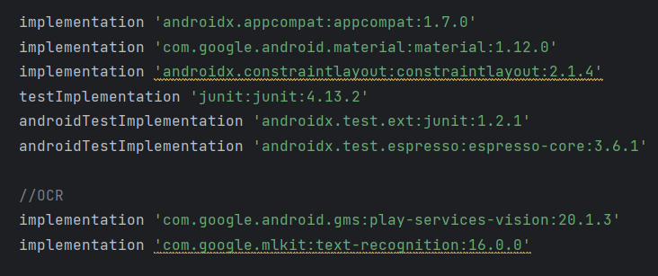
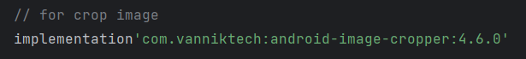
Setting and Configuration
Chapter 5 System
Implementation

Slide 23

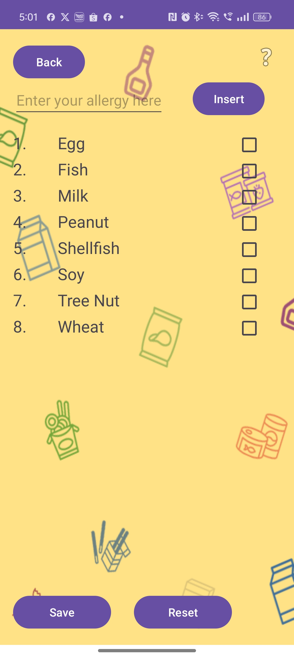
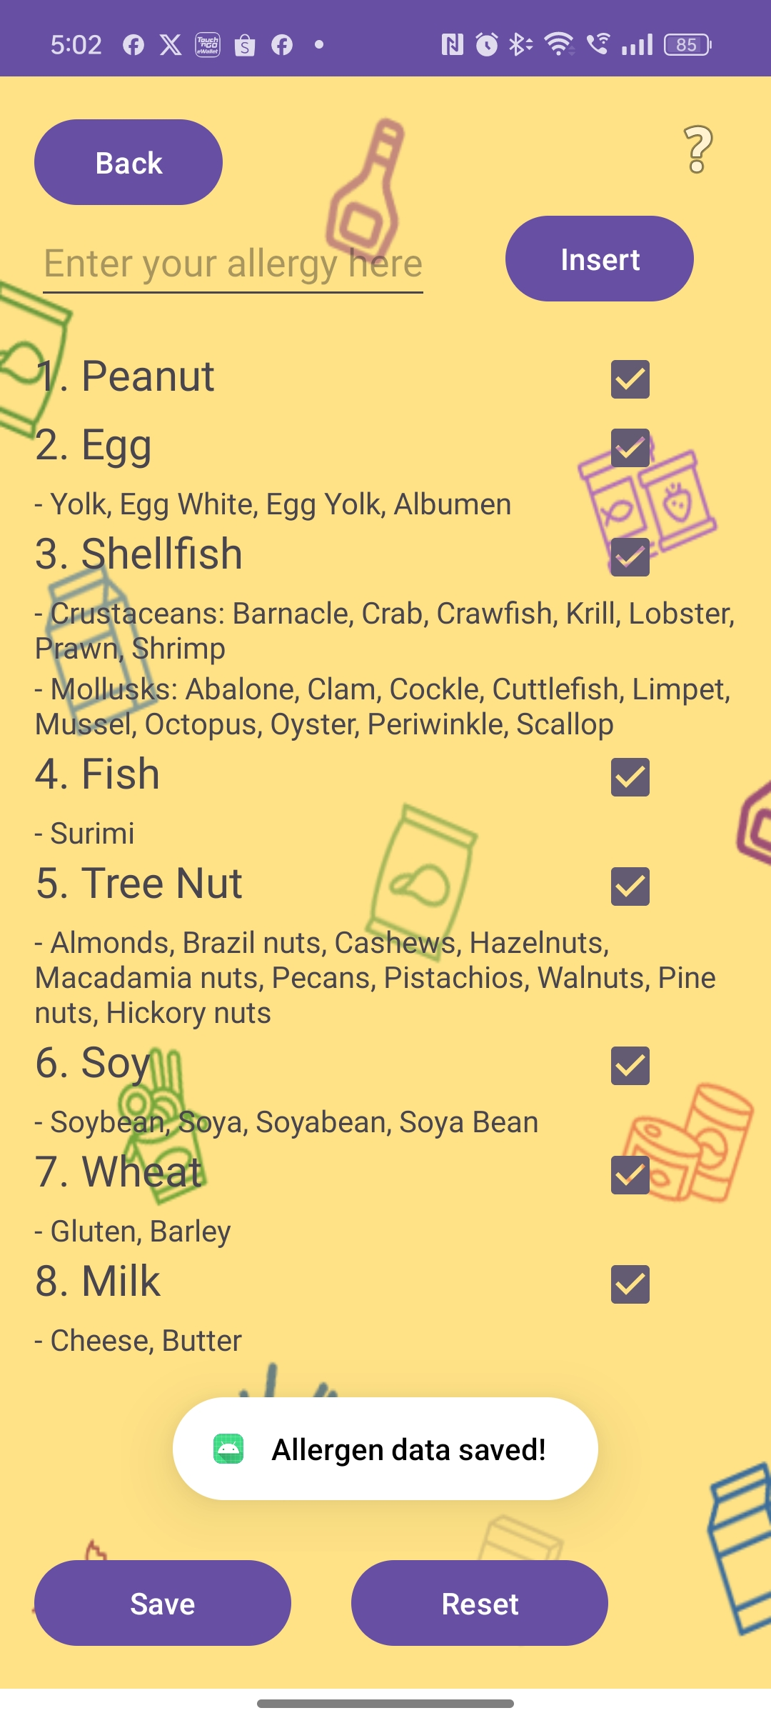
System Operation
Chapter 5 System
Implementation
Profile Page

Slide 24

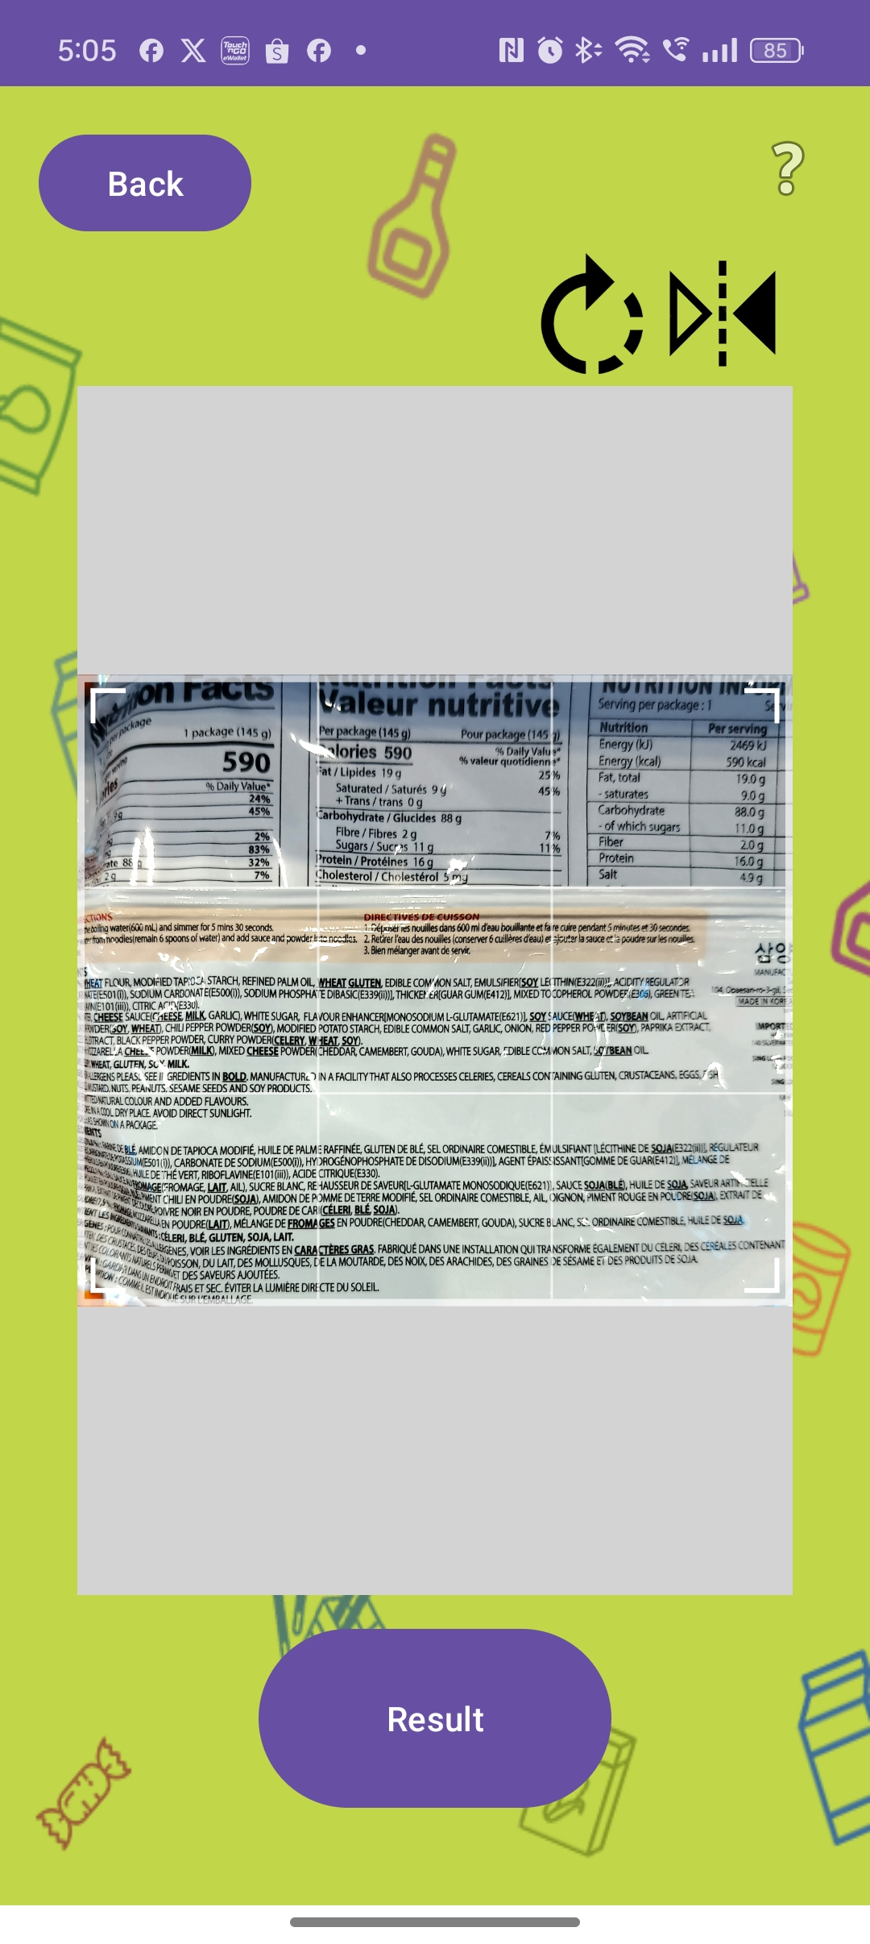
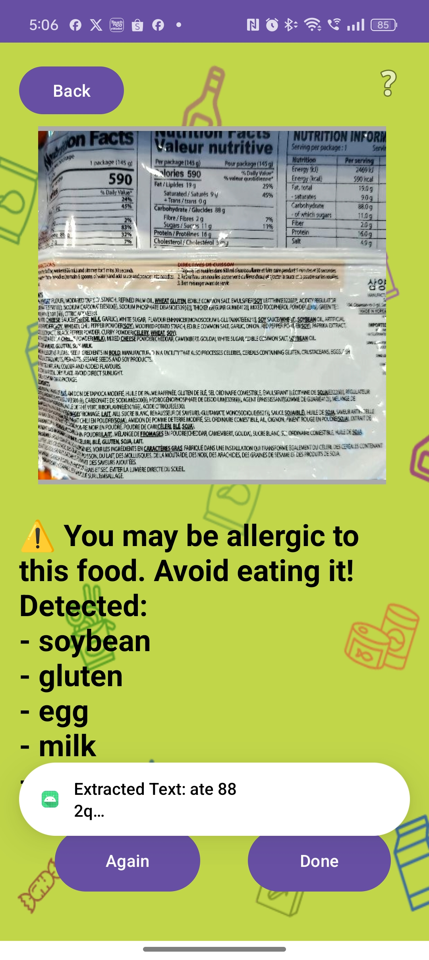
System Operation
Chapter 5 System
Implementation
Detect Page

Slide 25

System Operation
Chapter 5 System
Implementation
Other Page

Slide 26
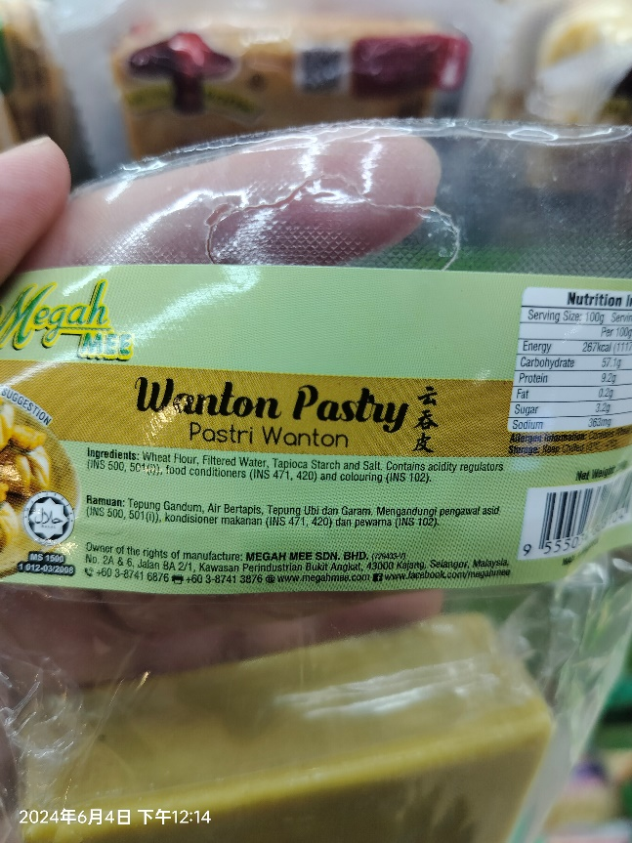
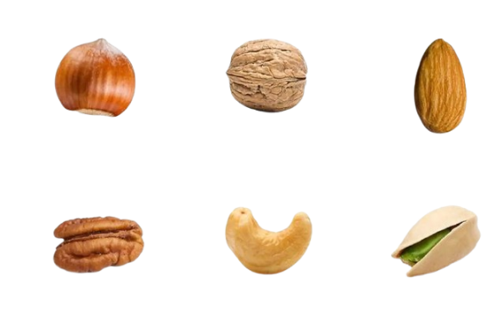
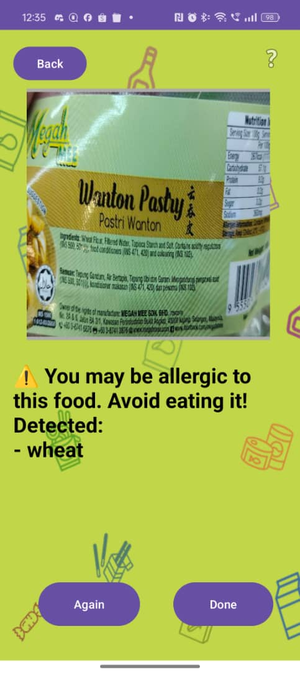
Implementation Issues and Challenges
Chapter 5 System
Implementation
1. Image Recognition Problems
2. Multiple Types of Allergen Groups
Tree Nut
Hazelnut Walnut Almond
Pecan Cashew Pistachio

Slide 27
System Testing and Performance Metrics
Chapter 6 System Evaluation And Discussion
6.1.1 Testing Types & Coverage
Single Allergen Detection:
tested with 10 photos.
Milk
Egg
Fish
Shellfish
Tree nuts
Peanuts
Wheat
Soybean
Multi-Allergen Detection:
50 images are prepared for testing two or three allergens in one image.
6.1.2 Testing Setup
Devices:
Mobile phones
Operating Environment:
work both online and offline,
Test Data:
uses a set of 500 randomly selected food images from a supermarket.
80 images
Notes:
so the tests are performed in both scenarios. The system will be tested in real-life environments, such as grocery stores, where users may either be connected to the internet or not.

Slide 28
Performance Metrics
Chapter 6 System Evaluation And Discussion
Response Time:
The time taken from uploading the image to receiving the allergen detection result.
Accuracy:
The percentage of correct allergen detections compared to the expected result.
Error Rate:
The error rate is especially important for multi-allergen detection, as the system should accurately identify all present allergens.

Slide 29
Single Allergen Detection
Chapter 6 System Evaluation And Discussion
Wheat
No. | Picture No. | 1st | 2nd
1 | 48 | / | -
2 | 53 | / | -
3 | 70 | / | -
4 | 71 | / | -
5 | 73 | / | -
6 | 77 | / | -
7 | 78 | / | -
8 | 82 | / | -
9 | 156 | / | -
10 | 159 | / | -
 |  | 10/10 | -
Milk
No. | Picture No. | 1st | 2nd
1 | 204 | / | -
2 | 205 | / | -
3 | 226 | / | -
4 | 227 | / | -
5 | 283 | / | -
6 | 287 | / | -
7 | 356 | / | -
8 | 414 | / | -
9 | 440 | / | -
10 | 456 | / | -
 |  | 10/10 | -
Peanut
No. | Picture No. | 1st | 2nd
1 | 183 | / | -
2 | 184 | / | -
3 | 209 | / | -
4 | 251 | / | -
5 | 263 | / | -
6 | 265 | / | -
7 | 302 | / | -
8 | 309 | / | -
9 | 381 | / | -
10 | 419 | / | -
 |  | 10/10 | -

Slide 30
Single Allergen Detection
Chapter 6 System Evaluation And Discussion
Fish
No. | Picture No. | 1st | 2nd
1 | 75 | / | -
2 | 87 | / | -
3 | 88 | / | -
4 | 109 | / | -
5 | 116 | / | -
6 | 117 | / | -
7 | 202 | / | -
8 | 235 | / | -
9 | 245 | / | -
10 | 390 | / | -
 |  | 10/10 | -
Egg
No. | Picture No. | 1st | 2nd
1 | 43 | / | -
2 | 46 | / | -
3 | 47 | / | -
4 | 50 | / | -
5 | 52 | / | -
6 | 72 | / | -
7 | 121* | / | -
8 | 358 | / | -
9 | 364 | / | -
10 | 459 | / | -
 |  | 10/10 | -
Soy
No. | Picture No. | 1st | 2nd
1 | 3 | / | -
2 | 6 | / | -
3 | 18 | / | -
4 | 220 | / | -
5 | 237 | / | -
6 | 277 | / | -
7 | 293 | / | -
8 | 319 | / | -
9 | 372 | / | -
10 | 408 | / | -
 |  | 10/10 | -

Slide 31
Single Allergen Detection
Chapter 6 System Evaluation And Discussion
Tree Nut
No. | Picture No. | 1st | 2nd | Type of Allergen for Tree Nut
1 | 182 | / | - | Hazelnuts
2 | 262 | / | - | Tree nut, Almonds，pecan
3 | 263 | / | - | Peanut, Milk, Soy, Tree Nut, Almonds
4 | 266 | / | - | Milk, Soy, Almonds
5 | 275 | / | - | Soy, Almond
6 | 315 | / | - | Wheat, Milk, hazelnuts, Almond
7 | 317 | / | - | Wheat, Soy, Milk, Hazelnut
8 | 425 | / | - | Wheat, Cashew nut, tree nut
9 | 450 | / | - | Wheat, Cashew nut, Egg, Milk
10 | 491 | / | - | Tree nut, Cashew
 |  | 10/10 | -
Shellfish
No. | Picture No. | 1st | 2nd | Type of Allergen for Shellfish
1 | 115* | / | - | Fish, Crab, Soybean
2 | 119* | / | - | Fish, Soybean, Shrimp, Crab
3 | 122* | / | - | Prawn
4 | 124 | / | - | Squid, Abalone, Soy Sauce
5 | 126 | / | - | Scallop
6 | 127 | / | - | Scallop
7 | 194 | / | - | Oysters, Wheat
8 | 195 | / | - | Oysters, Wheat
9 | 196 | / | - | Soybean, Wheat, Oysters
10 | 198 | / | - | Wheat, Scallop, Oysters
 |  | 10/10 | -

Slide 32
Multi-Allergen Detection
Chapter 6 System Evaluation And Discussion
No. | Picture No. | 2 allergen |  | 1st |  | 2nd
1 | 16 | Soybean | Egg | / | / | / | /
2 | 39 | Soybean | Wheat | / | / | / | /
3 | 51 | Wheat | Soy Sauce | / | / | / | /
4 | 58 | Egg | Soya Bean | / | / | / | /
5 | 74 | Wheat | Soy | / | / | / | /
6 | 76 | Wheat | Soy | / | / | / | /
7 | 97 | Wheat | Soybean | / | / | / | /
8 | 98 | Wheat | Soybean | / | / | / | /
9 | 157 | Wheat | Milk | / | / | / | /
10 | 164 | Wheat | Egg | / | / | / | /
11 | 260 | Milk | Tree Nuts | / | / | / | /
12 | 273 | Milk | soy | / | / | / | /
13 | 274 | Milk | soy | / | / | / | /
14 | 294 | Wheat | Milk | / | / | / | /
15 | 295 | Wheat | Milk | / | / | / | /
16 | 296 | Wheat | Milk | / | / | / | /
17 | 313 | Wheat | Soya | / | / | / | /
18 | 320 | Wheat | Milk | / | / | / | /
19 | 325 | Wheat | Egg | / | / | / | /
20 | 366 | Milk | Wheat | / | x | / | /
21 | 462 | Soybean | Milk | / | / | / | /
22 | 485 | Milk | Soya | / | / | / | /
23 | 493 | Milk | Wheat | / | / | / | /
24 | 496 | Wheat | Soy | / | / | / | /
25 | 498 | Soy | Wheat | / | / | / | /
 |  |  |  | 25/25 | 24/25 | 25/25 | 25/25

Slide 33
Multi-Allergen Detection
Chapter 6 System Evaluation And Discussion
No. | Picture No. | 3 allergens |  |  | 1st |  |  | 2nd
1 | 66 | Fish | Soy | Wheat | / | / | / | / | / | /
2 | 106 | Soybean | Wheat | Milk | / | / | / | / | / | /
3 | 108 | Wheat | Soybean | Fish | / | / | / | / | / | /
4 | 161 | Wheat | Milk | Egg | / | / | / | / | / | /
5 | 162 | Wheat | Milk | Egg | / | / | / | / | / | /
6 | 163 | Wheat | Milk | Egg | / | / | / | / | / | /
7 | 207 | Wheat | Milk | Soya | / | / | / | / | / | /
8 | 208 | Milk | Wheat | Egg | / | / | / | / | / | /
9 | 229 | Wheat | Soybean | Milk | / | / | x | / | / | /
10 | 231 | Milk | Egg | gluten | / | x | / | / | x | /
11 | 236 | Soybean | Egg | wheat | / | / | / | / | / | /
12 | 249 | Wheat | Soya | Fish | / | / | / | / | / | /
13 | 268 | Wheat | Soy | Milk | / | / | / | / | / | /
14 | 303 | Wheat | Milk | Soybean | / | / | / | / | / | /
15 | 305 | Wheat | Milk | Soya | / | / | / | / | / | /
16 | 306 | Milk | Wheat | Soybean | / | / | / | / | / | /
17 | 310 | Wheat | Milk | Soya | / | x | / | / | / | /
18 | 311 | Wheat | Soy | Milk | / | / | / | / | / | /
19 | 312 | Wheat | Milk | Soybean | / | / | / | / | / | /
20 | 316 | Wheat | Milk | Soya | / | / | / | / | / | /
21 | 383 | Wheat | Milk | Soy | / | / | / | / | / | /
22 | 410 | Wheat | Soy | Egg | / | / | / | / | / | /
23 | 423 | peanut | Wheat | soybean | / | / | / | / | / | /
24 | 454 | Wheat | Soy | Milk | / | / | / | / | / | /
25 | 458 | Wheat | Egg | Milk | / | / | / | / | / | /
 |  |  |  |  | 25/25 | 23/25 | 24/25 | 25/25 | 24/25 | 25/25

Slide 34
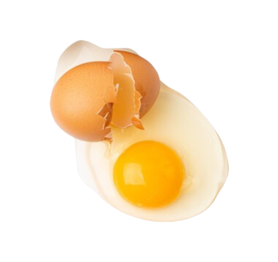
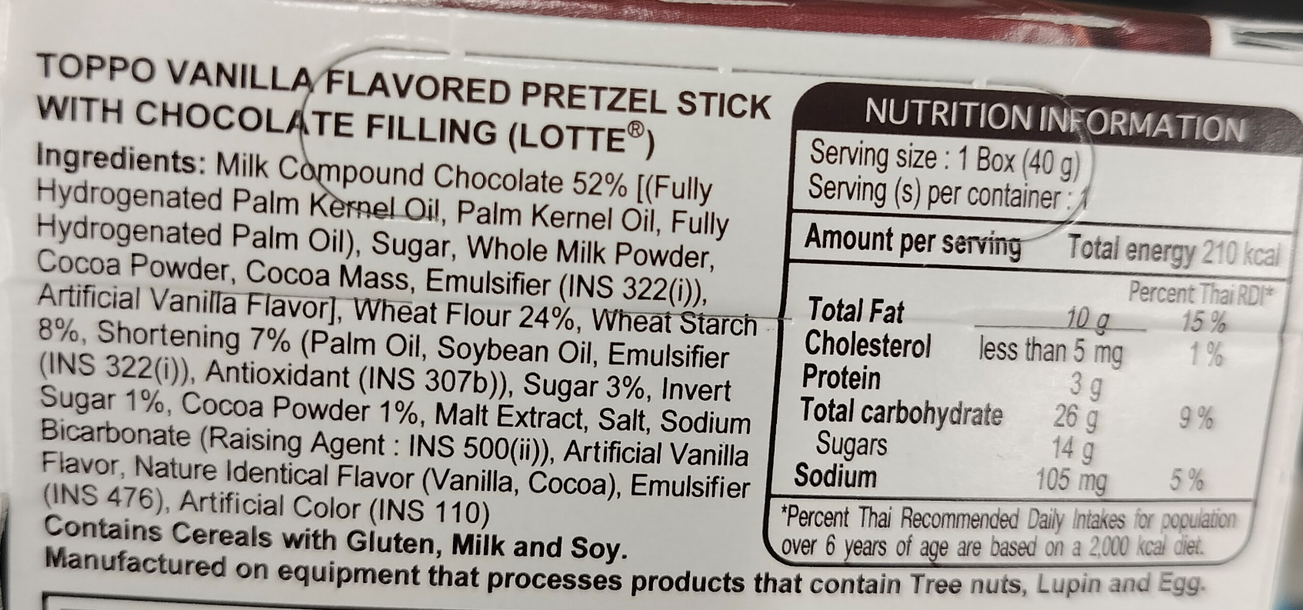
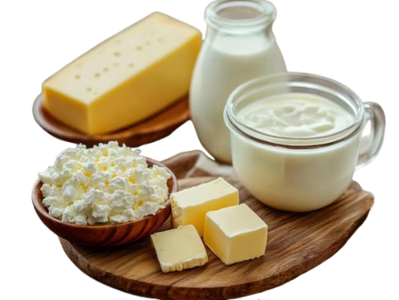
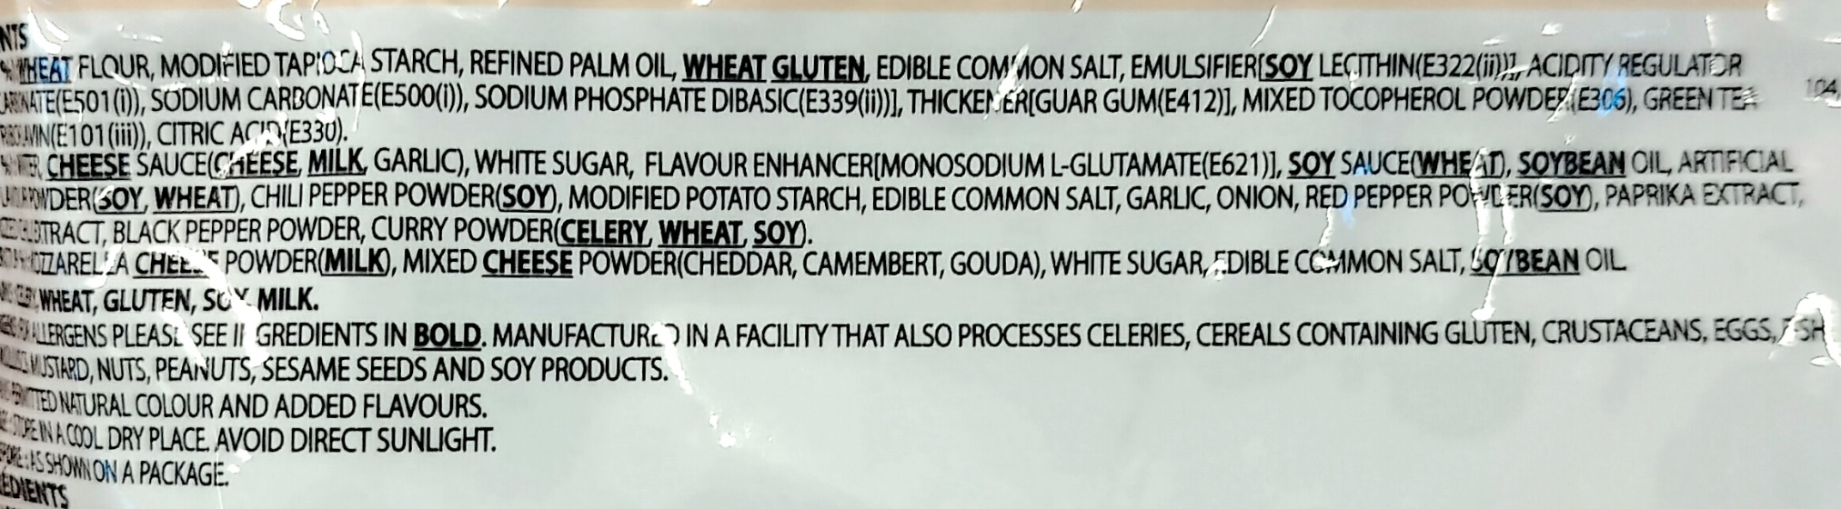
Project Challenges
Chapter 6 System Evaluation And Discussion
1. Different Names for the Same Allergen
2. Multiple Types of Allergen Groups
Egg White / Albumen
Egg Yolk / Yolk
Milk
Cream
Cheese
Butter

Slide 35
Objectives Evaluation
Chapter 6 System Evaluation And Discussion
Allergen Identification:
Enable allergen detection by photographing food ingredient lists.
Image Recognition Accuracy:
Achieve a minimum accuracy of 90% to ensure user safety and trust.
Database Objective Adjusted:
- Original goal of maintaining a database for 1,000 food types was not achieved.
- Shifted focus to enable simultaneous detection of multiple allergens in a single food ingredient list.

Slide 36
Conclusion
Chapter 7 Conclusion and Recommendation
Primary Goal:
Development of a user-friendly app to detect allergens in real-time and ensure user safety.
Key Features and Progress:
OCR technology to extract ingredient information from food labels.
Personalization through user-defined allergen inputs for customized alerts.
Reliable performance validated through extensive testing under various conditions.
Challenges and Solutions:
Low-quality images affecting OCR accuracy addressed with an image cropping feature.
Enhanced allergen detection and database refinement.

Slide 37
Recommendations
Chapter 7 Conclusion and Recommendation
Enhancements to Existing Features:
OCR Improvement:
- Advanced image processing techniques (e.g., noise reduction, image enhancement).
- handle diverse fonts and handwriting.
Allergen Database Expansion:
- Add synonyms for allergens to account for variations in naming.
- Enable user-generated content for database updates..
Future Research and Development:
1. User Experience Enhancements:
- Conduct regular updates and gather user feedback for continuous improvement.

